Slide 1
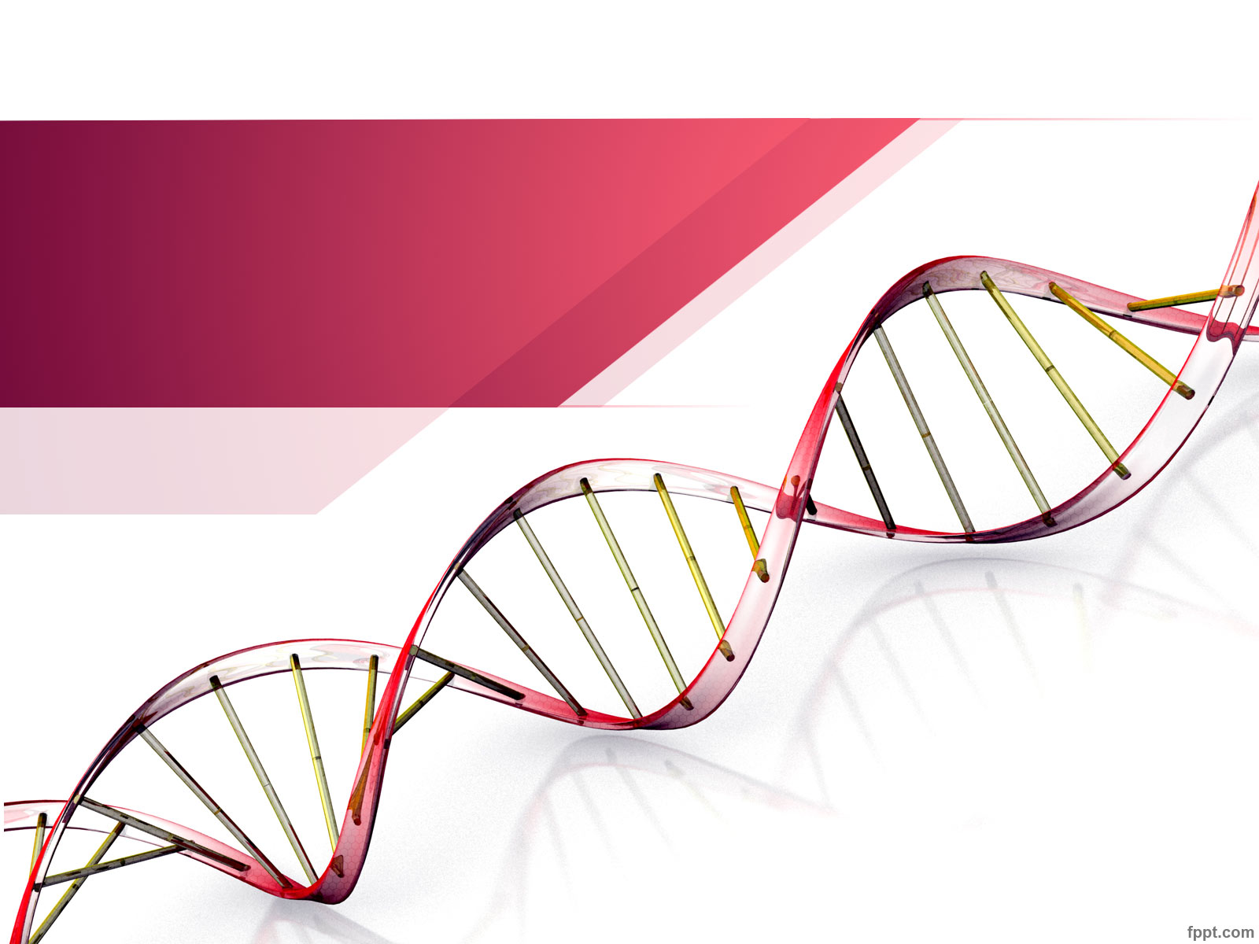
Unraveling our Genealogical DNA : Class 2
Produced by:
Choctaw County Genealogical Society
Spring of 2018

Slide 2
Help us … to help you ....
Do you know how to use a spreadsheet?
Which Browser to you use? Internet Explorer, Google or Google chrome, Firefox, etc
Ancestry Paid account vs Free account, who has what?
Notes:
Goals:
Confirm suspected connections, find unknown connections and determine Ethnicity.

Slide 3
Class 2: Agenda
Review Class 1 Glossary
Review Class 2 Glossary
Hand out: Cousin Chart, 2 charts from the Shared cM Project v3.0, Aug 2017.
Hand out: Video Syllabus
Video: Foundations in DNA 5 of 5: Autosomal DNA by
Blaine Bettinger, PhD., J.D.
Discussion:
Supplemental: How to extract DNA & Tree from Ancestry
Supplemental: How to extract DNA from 23andMe
Next Time: More on Ancestry or 3rd Party DNA Tools
Survey time….

Slide 4
Class 2: Glossary
cM -CentiMorgan (cM ) : The consecutive genetic distance where you match with another person on a Chromosome. Think of it as a measure of DNA information within a chromosome. Each chromosome contains different amounts of information. Chromosome 1 contains 281.5cM of information. Chromosome 2 has 263.7cM. Chromosome 21 has only 70.2cM.
SNPs or single-nucleotide polymorphisms (pronounced Snips)- are tiny pieces of a chromosome that contain distinct blocks of information. There are thousands of them per chromosome. SNPs are compared between two people to see if they match. The amount of information in matching SNPs is measured in cM.
Segment – a piece of DNA called a gene, that is passed down from parent to child. Refers to a section or block of contiguous SNPs. A "matching segment" is a section that is the same between two people.
Start and End Location - Individual markers (called base pairs - the things that SNPs are made of) within a chromosome are numbered. There are millions of these markers per chromosome. A segment of a chromosome can be identified by these location numbers.
IBS and IBD - Sometimes SNPs marker values match between two people simply by chance. This is called IBS or Identical By State. And sometimes they match because they were passed down from a common ancestor. This is called IBD or Identical By Descent.
MRCA - This is Most Recent Common Ancestor - the ancestor from which you and a DNA match received your common DNA

Slide 5
Class 2: End of Class Survey
Did tonight’s class meet your expectations? Yes / No
What part of the class did you find the most interesting?
______________________________________________________
What part of the class was the hardest for you?
______________________________________________________
How could CCGS improve the class?
______________________________________________________
______________________________________________________
Would you be interested in attending more DNA classes? Yes / No
Your name: _____________________________________________

Slide 6
In the end …
Recap Autosomal DNA
Next class expectations
Homework
Give us feed back via the survey …...

Slide 7
References:
Interactive cM Relative Calculator:https://dnapainter.com/tools/sharedcmv4
Cousin Chart
https://isogg.org/wiki/Cousin
http://www.jadecat.com/fam/cousins.html

