Slide 1
Unraveling our Genealogical DNA: 23andMe DNA Extract Supplemental
Produced by:
Choctaw County Genealogical Society
Spring of 2018

Slide 2
23andMe DNA: Extract How-to
Extract 23andMe DNA
Follow the instructions on the next few pages …

Slide 3
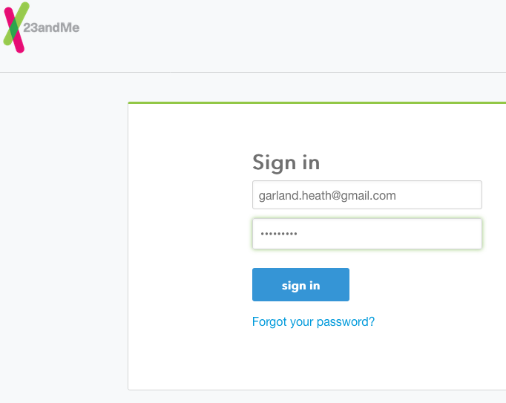
23andMe DNA: Log in
Notes:
Here is how you extract your Ancestry DNA ;
0. Login to Ancestry and go to DNA area
1. On the DNA homepage, Access 'Settings’
3. On right side, "Download Raw DNA Data" button, Press button
4. On pop-up, fill in your Ancestry password, check the box so you accept all responsibility and Press Confirm button
5. Another pop-up window.....waiting... leave until you have completely finish then close
6. Go to your email and access an email sent from Ancestry
7. In email, follow the instructions
8. The Ancestry Raw DNA data file will be downloaded to your computer.
9. I would update the file name to include where it came from (Ancestry) and who it belongs to (Larry-Masco). I add this behind the Ancestry file name.

Slide 4
23andMe DNA: Home page

Slide 5
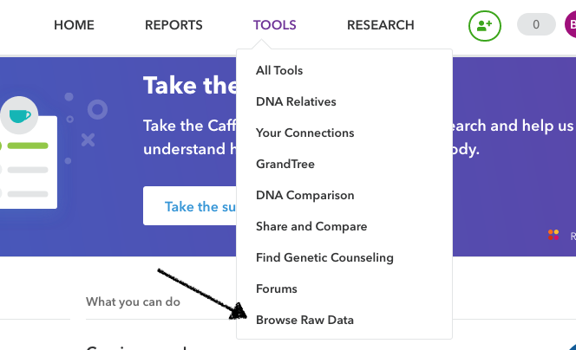
23andMe DNA: Begin Extract
Notes:
Access DNA Settings

Slide 6
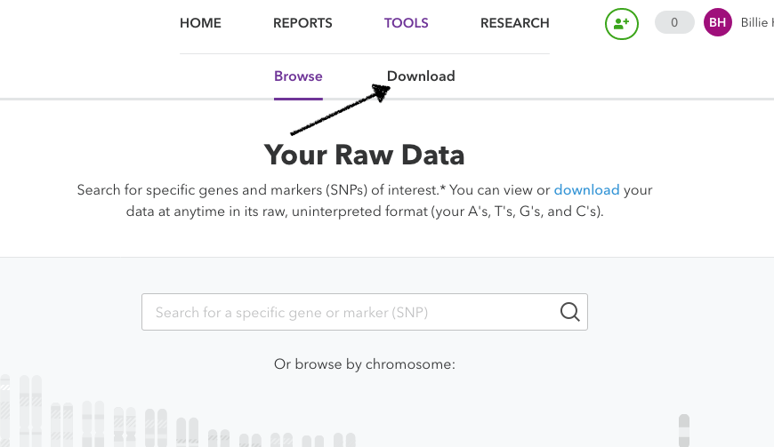
23andMe DNA:

Slide 7
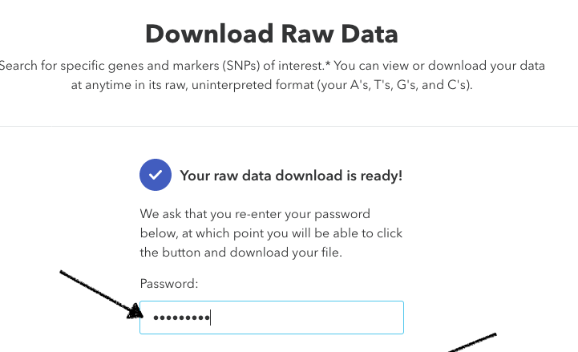
23andMe DNA:
Notes:
Enter Password, checkCheck box , Confirm button opens, press.

Slide 8
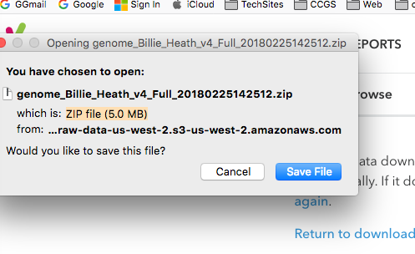
23andMe DNA:
Notes:
Press the “Confirm Data Download” button.
Another Ancestry window will open.

Slide 9
23andMe DNA: On your computer

Slide 10
23andMe DNA: On your computer … rename file.
Notes:
On your computer: Ancestry text file explaining the do’s and don’ts of your DNA results

Slide 11
23andMe DNA: Extract Complete
23andMe sent you, 1 file;
Genome_Billie_Heath_V4_Full_20180225142512.zip , which you need to rename
Suggested renaming structure:
Add DNA test site, 23andMe, to the end of the file name;
Example:
geome_Billie_Heath_v4_Full_20180224152412_23andMe.zip

Slide 12
23andMe: In the end …
You have extracted your 23andMe DNA results to your computer
You renamed the extracted DNA file on your computer
You are ready to import 23andMe DNA into a 3rd party software analysis tool.
Notes:
Recap

